Slide 1


ADVANCED EXCEL FEATURES
DATE: January 20, 2024
PRESENTED BY: TUSHAR GOYAL I SANSKAR JAIN
MENTORED BY: ISHA CHHABRA

Slide 2


FEATURES DESCRIPTION
VLOOKUP
HLOOKUP
XLOOKUP
INDEX MATCH
PIVOT TABLE
ADVANCE SORT
ADVANCE TRANSPOSE
ADVANCE SELECTION
VSTACK
GO TO SPECIAL
TEXT FUNCTIONS
CHOOSE FUNCTION
FILTER FUNCTION
LOGICAL FUNCTIONS
ISBLANK
CONDITIONAL FORMATTING
MULTIPLE FOLDERS IN ONE GO
vkalra.com

Slide 3


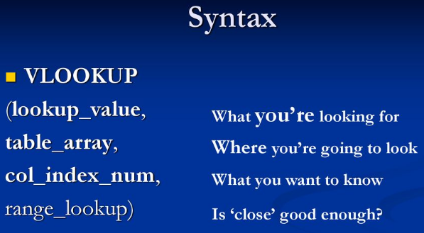
VLOOKUP
VLOOKUP stands for ‘Vertical Lookup’. It is a function that makes Excel search for a certain value in a column (the so called ‘table array’), in order to return a value from a different column in the same row.
When to use VLOOKUP function :-
To combine information from multiple data sources
Check to see if a specific value exists.
A VLOOKUP function exists of 4 components:-
The value you want to look up;
The range in which you want to find the value and the return value;
The number of the COLUMN within your defined range, that contains the return value;
0 or FALSE for an exact match with the value you are looking for; 1 or TRUE for an approximate match.
vkalra.com

Slide 4
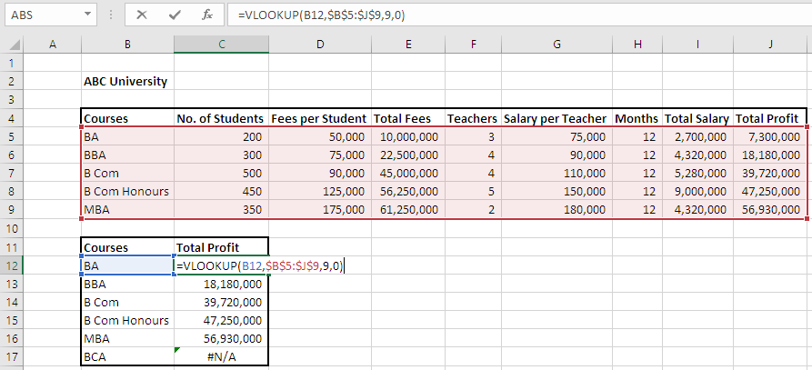


PRACTICAL UNDERSTANDING
vkalra.com

Slide 5

HLOOKUP
HLOOKUP stands for ‘Horizontal Lookup’ and can be used to retrieve information from a table by searching a row for the matching data and outputting from the corresponding column.
A HLOOKUP function exists of 4 components:-
The value you want to look up;
The range in which you want to find the value and the return value;
The number of the ROW within your defined range, that contains the return value;
0 or FALSE for an exact match with the value you are looking for; 1 or TRUE for an approximate match.
Difference Between VLOOKUP & HLOOKUP
The VLOOKUP function is used to look up a particular value in a table array organized vertically and then return data from a specified column against that value.
Whereas we use the HLOOKUP to lookup a value horizontally. This is done by searching the top row of the table for a specified value and in return giving back the value in the same column.
vkalra.com

Slide 6
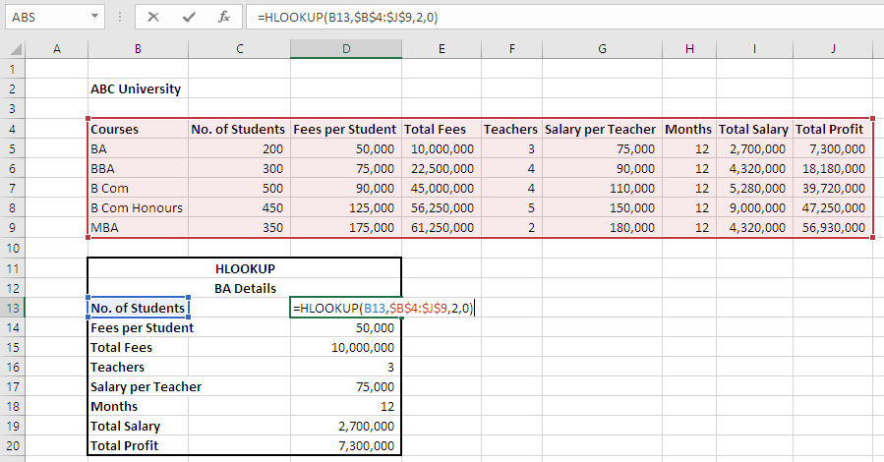


PRACTICAL UNDERSTANDING
vkalra.com

Slide 7


XLOOKUP
The core functionality of the XLOOKUP is the ability to search for specific values in a range or array of data. When you run the function, a corresponding value is returned from another range or array.
In other words, the Excel XLOOKUP function is a modern and flexible replacement for older functions like VLOOKUP & HLOOKUP. XLOOKUP supports approximate and exact matching, wildcards (* ?) for partial matches, and lookups in vertical or horizontal ranges.
A XLOOKUP function exists of 6 components:-
lookup - The lookup value.
lookup_array - The array or range to search.
return_array - The array or range to return.
not_found - [optional] Value to return if no match found.
match_mode - [optional] 0 = exact match (default), -1 = exact match or next smallest, 1 = exact match or next larger, 2 = wildcard match.
search_mode - [optional] 1 = search from first (default), -1 = search from last, 2 = binary search ascending, -2 = binary search descending.
vkalra.com

Slide 8


XLOOKUP Benefits
XLOOKUP can lookup data to the right or left of lookup values.
XLOOKUP can return multiple results
XLOOKUP can work with vertical & horizontal data
XLOOKUP can perform a reverse search (bottom to top)
XLOOKUP can return a default value if an exact match isn’t found
XLOOKUP can provide us to re-name an error as per our understanding/requirement.
vkalra.com

Slide 9
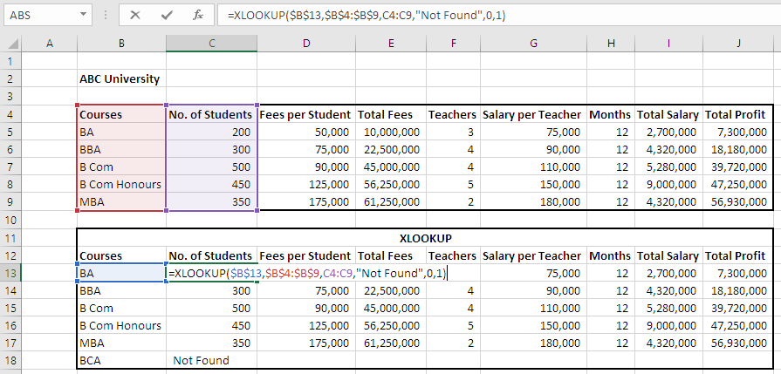
PRACTICAL UNDERSTANDING
ILLUSTRATION-1
vkalra.com

Slide 10
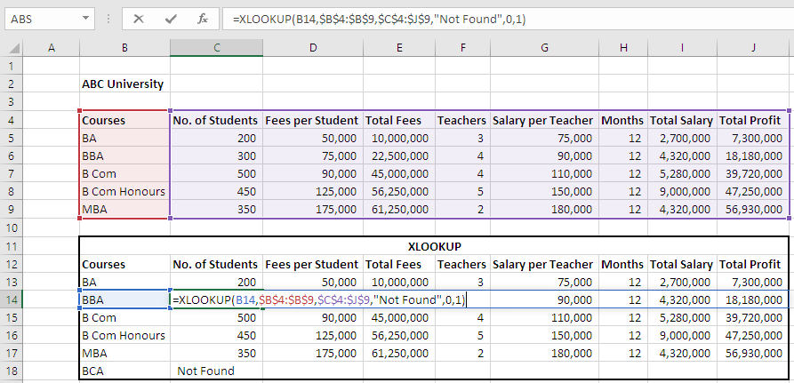
PRACTICAL UNDERSTANDING
ILLUSTRATION-2
vkalra.com

Slide 11
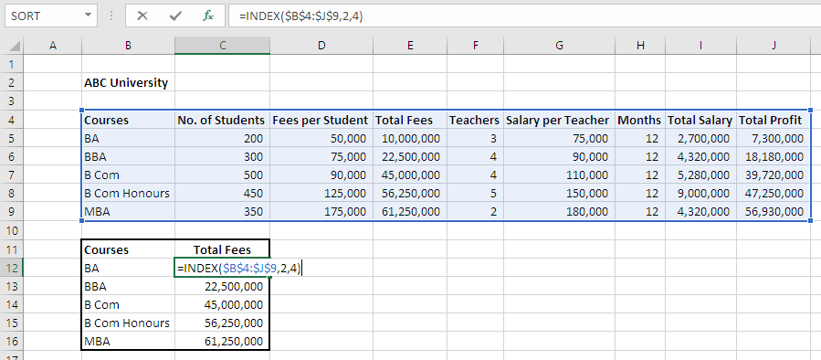

INDEX
INDEX formula returns a cell reference from within a given array or range.
PRACTICAL UNDERSTANDING
vkalra.com

Slide 12
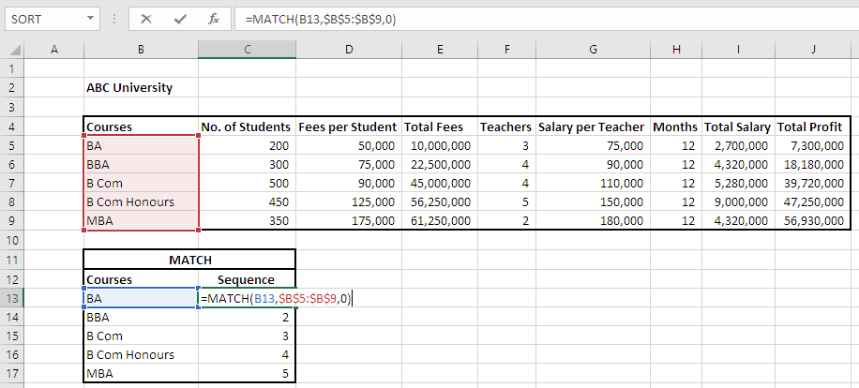


MATCH
MATCH formula looks up a value in an array and returns the position of the value within the array.
PRACTICAL UNDERSTANDING
vkalra.com

Slide 13


INDEX MATCH
The INDEX and MATCH formulas, when nested, can perform a lookup that accomplishes what the VLOOKUP does and more. Nesting a formula means using one entire formula as an argument of another function.
This includes looking up values that are to the left of the lookup value, accepting approximate matches when the list is sorted in descending order, and even returning values that match multiple criteria.
vkalra.com

Slide 14
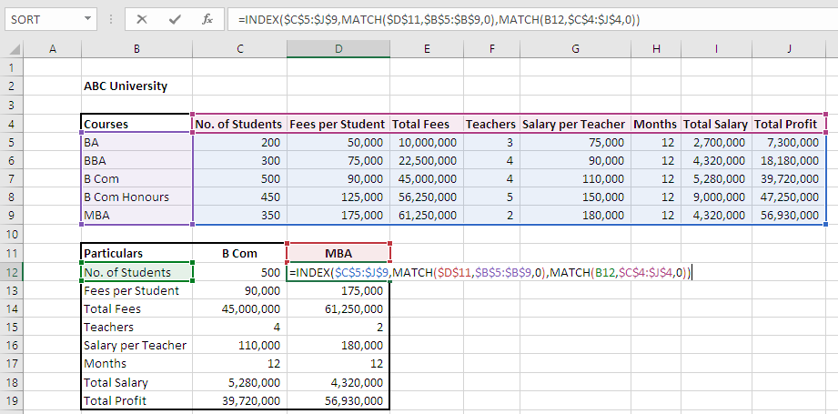
PRACTICAL UNDERSTANDING
vkalra.com

Slide 15
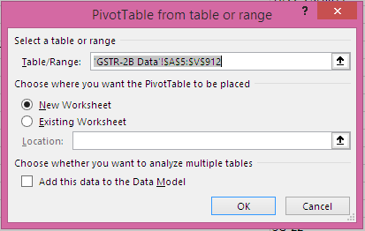
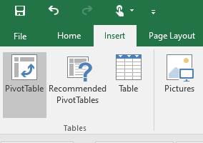
PIVOT TABLE
A pivot table (Alt+N+V+T) is a statistics tool that summarizes and reorganizes selected columns and rows of data in a spreadsheet or database table to obtain a desired report. The tool does not actually change the spreadsheet or database itself, it simply “pivots” (which means the central point on which something balances) or turns the data to view it from different perspectives.
Pivot tables are especially useful with large amounts of data that would be time-consuming to calculate by hand. A few data processing functions a pivot table can perform include identifying sums, averages, ranges or outliers. The table then arranges this information in a simple, meaningful layout that draws attention to key values.
vkalra.com

Slide 16
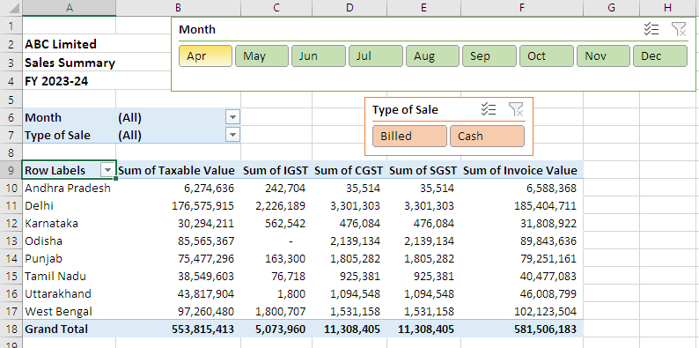
PRACTICAL UNDERSTANDING
vkalra.com

Slide 17
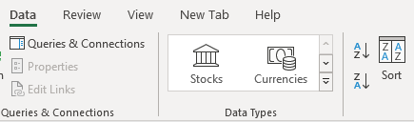
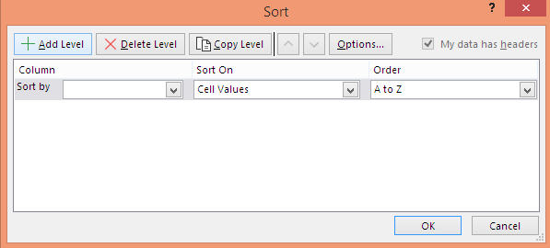
ADVANCE SORT
The advanced sorting function (Alt+A+S+A or Alt+A+S+D) is used to apply sorts on multiple columns in a report. It enables the report author to specify the column order and sort direction that they desire the report to be sorted by.
Sorting a report is one of the ways you can manipulate data display without re-executing the report against the warehouse. You can perform a quick sort, which allows you to sort a single column or row.
vkalra.com

Slide 18
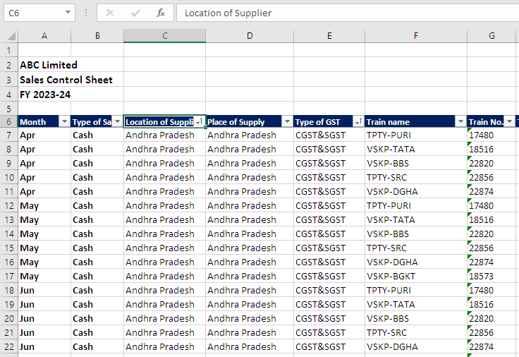
PRACTICAL UNDERSTANDING
vkalra.com

Slide 19


ADVANCE TRANSPOSE
The purpose of the TRANSPOSE function (Alt+H+V+T) in Excel is to convert rows to columns, i.e. switch the orientation of a given range from horizontal to vertical or vice versa.
Sometimes you need to switch or rotate cells. You can do this by copying, pasting, and using the Transpose option. But doing that creates duplicated data. If you don't want that, you can type a formula instead using the TRANSPOSE function.
vkalra.com

Slide 20
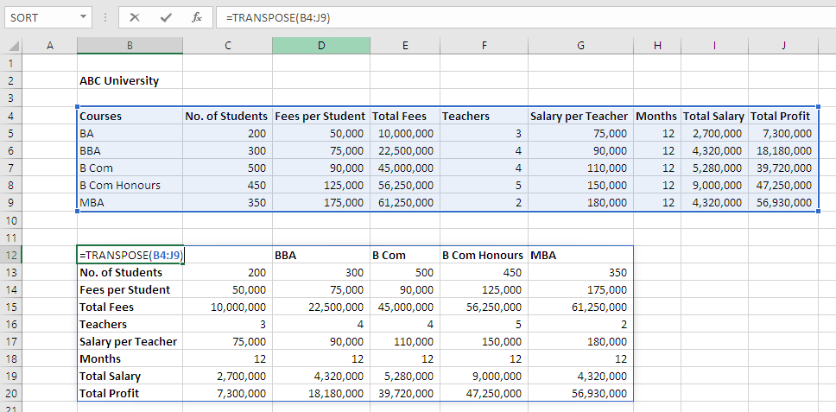
PRACTICAL UNDERSTANDING
vkalra.com

Slide 21
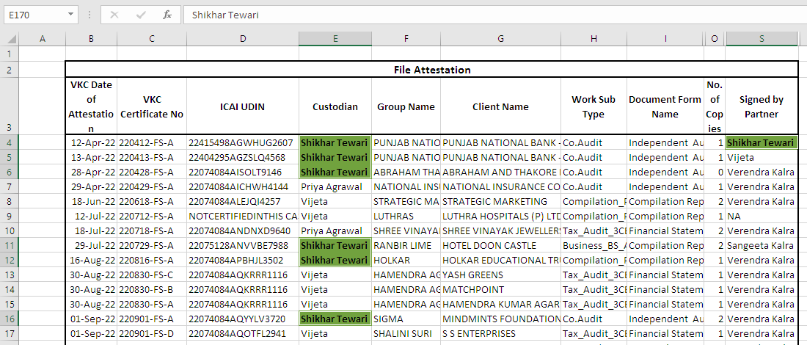
ADVANCE SELECTION
ADVANCE SELECTION function in excel is the process of selecting or choosing the data you want to change, highlight or modify from that particular excelsheet. It also helps us to identify the errors
in the selected data.
PRACTICAL UNDERSTANDING
vkalra.com

Slide 22
MCQs
In Excel, what does the "PivotTable" feature allow you to do?
a) Summarize and analyze data
b) Creates charts
c) Merge cells
d) Apply conditional formatting
vkalra.com

Slide 23
MCQs
2. Which of the following is a Function that will now helps us in doing our work more effectively, efficiently and saves our time?
a) VLOOKUP Function
b) XLOOKUP Function
c) INDEX MATCH Function
d) HLOOKUP Function
vkalra.com

Slide 24
MCQs
3. Which of the following is a not a short-cut key of SORT?
a) Alt+A+S+A
b) Alt+A+S+B
c) Alt+A+S+D
d) None of the above
vkalra.com

Slide 25
MCQs
4. Which Excel function is used for counting the number of cells that meet a specific condition?
a) COUNT
b) SUM
c) IF
d) COUNTIF
vkalra.com

Slide 26
MCQs
5. What is the purpose of the "INDEX" function in Excel?
a) Lookup a value in a range
b) Return the intersection of a row and column
c) Calculate the average
d) Count the number of cells in a range
vkalra.com

Slide 27
MCQs
6. Which Excel feature allows you to automate repetitive tasks by recording a sequence of actions?
a) Data Validation
b) Conditional Formatting
c) Macros
d) Goal Seek
vkalra.com

Slide 28
MCQs
7. What function can be used to find the largest value in a range in Excel?
a) MAX
b) LARGE
c) SUM
d) AVERAGE
vkalra.com

Slide 29
MCQs
8. How can you freeze the top row and left column in Excel to keep them visible while scrolling?
a) Freeze Panes
b) Lock Cells
c) Split Window
d) Hide Rows
vkalra.com

Slide 30
MCQs
9. What does the "MATCH" function in Excel do?
a) Find the median of a range
b) Search for a value in a range and return its relative position
c) Calculate the standard deviation
d) Count the number of unique values in a range
vkalra.com

Slide 31
MCQs
10. In Excel, how can you create a drop-down list in a cell?
a) Data Validation
b) Conditional Formatting
c) PivotTable
d) Goal Seek
vkalra.com

Slide 32
MCQs
11. Which Excel function is used to extract specific characters from a text string based on their position?
a) RIGHT
b) LEFT
c) MID
d) FIND
vkalra.com

Slide 33
MCQs
12. How can you protect a worksheet in Excel, so that users can only edit certain cells?
a) Data Validation
b) Worksheet Protection
c) Lock Cells
d) Conditional Formatting
vkalra.com

Slide 34



Thank You
3rd Floor, MJ Tower,
55, Rajpur Road,
Dehradun - 248001
T: +91.135.2743283
+91.135.2747084
W: vkalra.com
Follow us on

